Slide 1
Introduction to NoSQL
-Satyendra Singh Gaur

Slide 2
Why NoSQL?
Agenda:-
Database
The Value of Relational Database
Impedance Mismatch
Attack of the Clusters
The Emergence of NoSQL

Slide 3
Database
Why we need to store data?
Collection of data gives you information.
Where can we store data?
Fast, small and volatile(Main Memory)
Slow, large and persistent (Backing Store - Disk)
What do we need to store data in Disk?
Data Storage
MySQL
Oracle DB
MS Sql Server
Rows and Columns
(RDBMS)

Slide 4
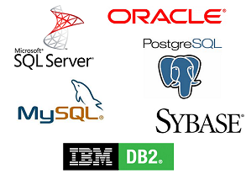
Some Relational Databases or RDBMS

Slide 5
The Value of Relational Databases
Persistent Data
SQL (It made RDBMS standard database)
Transactions
Integration
Reporting

Slide 6
Is there any problem with Relational Databases?

Slide 7
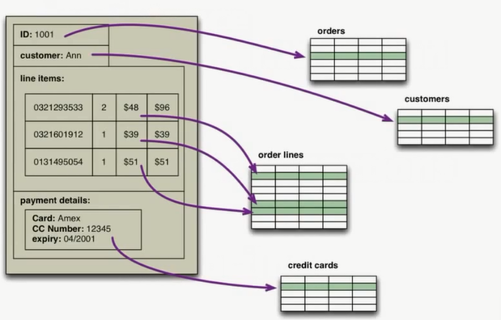

Slide 8
Impedance Mismatch
IM always frustrated the Application developers from the beginning itself.
What is Impedance Mismatch?
Difference between the data in Main Memory(In-Memory data structures) and Disk (RDBMS).
To get rid of this IM. In 1990s, people started working on it.
They came up with something called as Object-Oriented databases and Object-Oriented programming.

Slide 9
Impedance Mismatch
Though Object-Oriented programming got succeeded in becoming major force in programming, Object-Oriented databases faded.
Because, RDBMS had Standard language(SQL) and growing SQL professionals made it popular.
Also, IM has been made much easier to deal with ORM frameworks.
But, ORM tools become a problem when people try too hard to ignore the database and query performance suffers.

Slide 10
In the year 2000s
During this year, cracks began to open in RDBMS’s dominance.

Slide 11
Integration Database
Why RDBMS triumphed over OO databases?
The role of SQL as a integration mechanism between applications helped RDBMS to become shared database.
Drawbacks of shared database integration:-
The structure(designed to integrate many applications) become more complex.
Any changes needed by one application will need to coordinate with all the other applications using the common database.
Problem of Indexing.
To preserve database integrity, you have to implement it within the database(in the form of SP and func..)

Slide 12
Application Database
Directly accessed by a single application.
Controlled by one team who is handling both application and database.
Easier to maintain and extend/add/modify the schema.
Database integrity can be put into application code.

Slide 13
Here comes the “Data Age”
Developers started feeling the busting of the 1990s dot-com bubble from the year 2000.
Websites started tracking activity in a detailed way.
Large sets of data appeared:-
Social networks
Activity logs
This leads to growth in data and came growth in users.
The websites grew by regularly serving huge number of visitors.

Slide 14

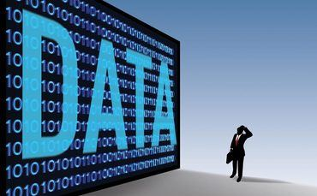

Some facts about Facebook
Collects 500 TB of data in a day.
6,84,478 Posts in a minute.
There are now over 1.15 billion Facebook users
34,778 likes on posts by various brands and organizations.

Slide 15


Some facts about Google
20,00,000 search queries in a minute.
More than 2,00,00,000 of emails are send every minute
This is gowing at 33% per
annum.

Slide 16
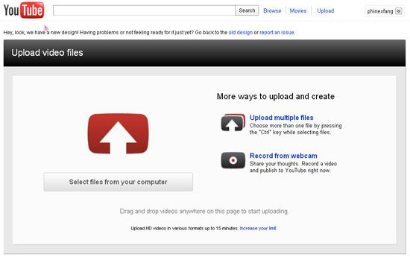
Some facts about YouTube
54 hours of videos are upoaded every minute

Slide 17
Some other Facts!
Mobile Web
217 new users every minute
Websites:
571 new websites are created every minute.
Flickr:
3,125 new photos every minute.
Apple:
47,000 apps downloads
Twitter:
1,00,000 tweets every minute.
Web Shopping:
20,00,000 Rupees are spend on web shopping.

Slide 18
“I know it sounds corny, But I’d love to improve people’s lives, especially socially… making the world more open is not an over night thing, It’s a ten to fifteen year thing”
-Mark Zuckerberg

Slide 19
Data Never Sleeps
With no signs of slowing, data keeps growing.
The global internet population grew 6.59% from 2010 to 2011.
And now, It represents 2.1 billion people.

Slide 20
Why are we collecting so much Data?
In networks companies like airtel/Vodafone in India, AT&T in US, monitor routers logs where information of subscriber phone id, call id is recorded, to find top subscribers and install routers where traffic is more etc.
Google, Amazon, Ebay, Facebook they get logs so that ads and products can be recommended to customers

Slide 21
The Three ‘V’
Volume
Variety
Velocity
How do we handle our websites to store and process large amount of data coming at higher speed?

Slide 22
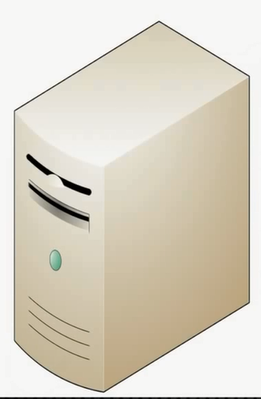
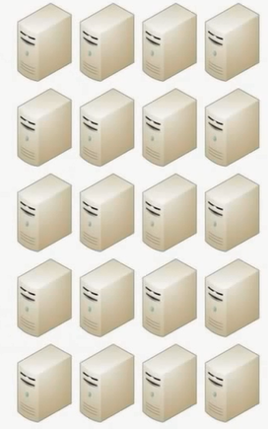
The 2 choices
Scale Up
Scale Out

Slide 23
Pros and cons
Scaling Up
Scaling Up implies bigger machines, more processors, disk storage and more memory.
But, it becomes more expensive for organizations.
Scaling Out
Scaling Out implies lots of small machines in a clusters.
Cheaper as it uses commodity hardware.
Reliable as there are many machines to take up the request if one fails.

Slide 24
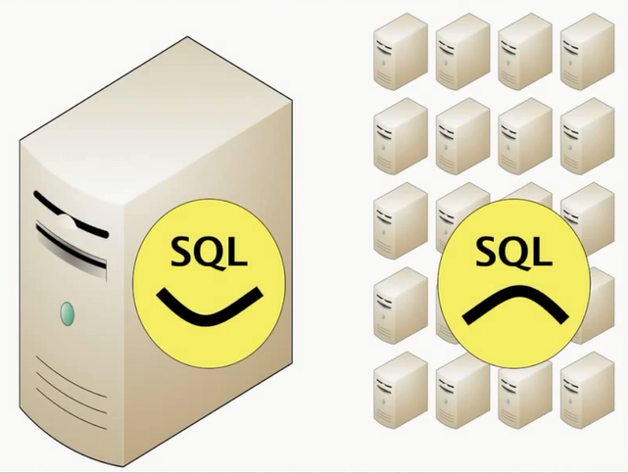
Does it work?

Slide 25
Attack of the Clusters
As the large properties moved towards the clusters, that revealed a new problem.
RDBMS are not designed to be run on clusters.
Their exist single point of failure if disk subsystem fails.
Running on a cluster leads to serious price hike.
Notes:
Clustered Relational databases like Oracle RAC or Microsoft SQL Server work on the concept shared disk subsystem.
It uses cluster-aware filesystem that writes to a highly available disk subsystem.
Sharding(Separate Servers for different sets of data) is also present but it loses querying, referential intergrity, transactions and consistency.

Slide 26


Then, What happened?
These mismatch between clusters and RDBMS led some organization to consider an alternative route to data storage.
Google and Amazon both were in forefront of running large clusters of this kind.
They were capturing huge amounts of data.

Slide 27
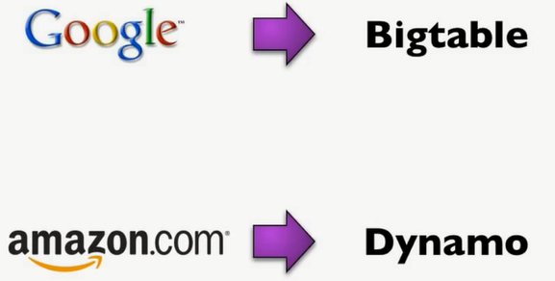
Google and Amazon, What they did?
As the 2000s drew both companies produced brief but highly influential papers about their efforts:-

Slide 28
The Emergence of NoSQL
The term “NoSQL” first made its appearance in the late 90s as the name of the open-source Relational database – “Strozzi NoSQL” by Carlo Strozzi.
It didn’t use any SQL queries but the unix commands with pipelines and hence, NoSQL.
Other than the terminology, Strozzi’s NoSQL does not have any influence on “NoSQL” which we are going to discuss.

Slide 29
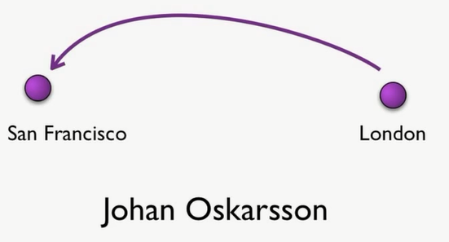
June 2009

Slide 30
San Francisco, June 11, 2009
A meet up was organized by Johan Orkarsson, Software Developer based in London.
After the release of white papers on Big Table and Dynamo, their were many experimentation happened from different corners of the world.
Johan wanted to find out more about some these databases.
So he decided to host a meetup where they could all come together and present their work.
Johan wanted a name for the meetup:-
Something that would make a good Twitter hashtag.
Short, Memorable, without too many google hits.

Slide 31
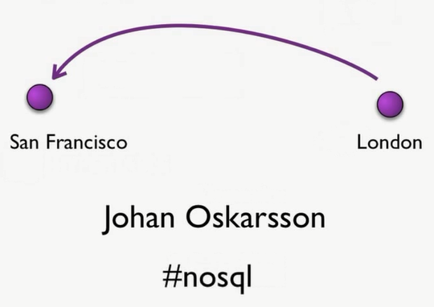

Slide 32
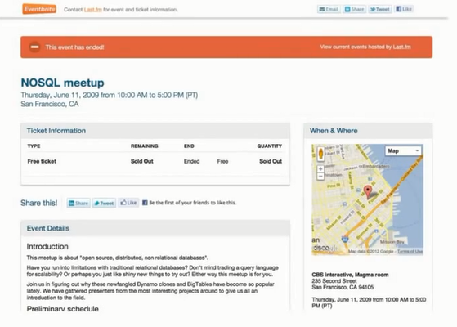

Slide 33
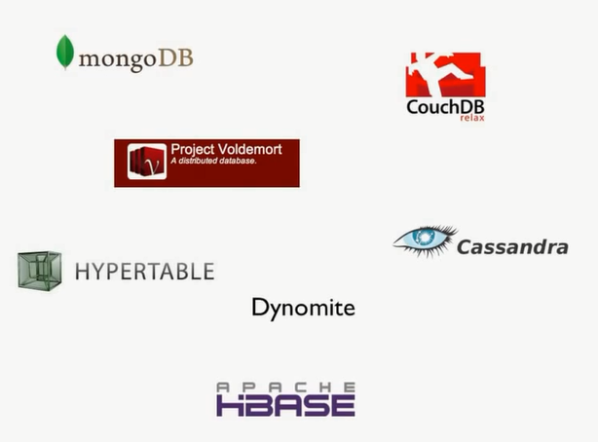

Slide 34
NoSQL
“NoSQL” is applied to a database which has some common characteristics:-
Not using the relational model
Running well on Clusters.
Open-Source.
Built for the 21st Century web.
Flexible Schema or Schemaless.

Slide 35
Summary
RDBMS is successful technology for 2 decades, providing persistence, concurrency, integration etc…
App Developers were frustrated with the IM.
The vital factor for a change in data storage was the need to support large volumes of data by running on clusters.
RDBMS are not designed to run on clusters.
The Common Characteristics of NoSQL databases are:-
Not using relational model
Running well on clusters
Open-Source
Built for the 21st Century.
Schemales or Flexible Schema

Slide 36
Questions

Slide 37
Thank You!

